Slide 1
BarraOne Stress Test Process
Han Zhang, Charles Liu, Ligang Wang

Slide 2
Stress Test Process Overview – BRC GFC vs. BarraOne (B1)
Current GFC stress test uses quarterly earning sensitivity (ES) and internal GFC shocks to estimate impact.
BarraOne(B1) Stress Test
Asset Impact – BarraOne provides the stress impact on asset.
Shock Conversion – Convert B1 scenario shocks and asset returns to market factors.
ES-based Liability/Net Impact – Blend quarterly earning sensitivities (ES) with factors from B.
Net Impact Summary– Combine asset impact and liability impact or use blended net earnings sensitivity, depending on the ES segment’s scaling method.
E. Aggregation – net impacts are summarized by ES segment and rolled up to the company level by asset group (interest rates, public equity, ALDA, currency).
Quarterly Earning Sensitivity (Net)
Internal GFC Shock Factors
Earnings and Balance Sheet (Net) Impact
BarraOne Asset Impact
Quarterly Earning Sensitivity (Liability)
BarraOne Shock Factors
Earnings and Balance Sheet (Net) Impact

Slide 3
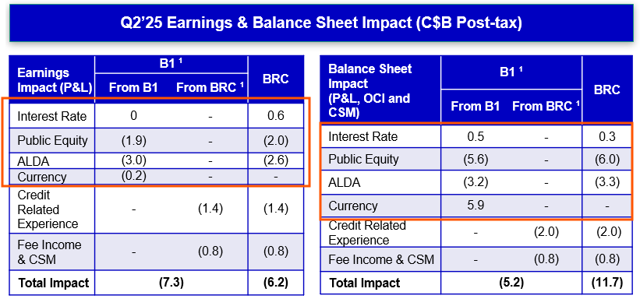
BarraOne Stress Test – Sample Output

Slide 4
BarraOne Stress Test Automation (Future State)
Portfolio – ES Segment Mapping
Asset Impact with FX and without FX (B1);
GA Position (B1, Internal)
A. BarraOne Asset Impact + FX Impact
Stress Scenario IR and FX Shocks (B1)
B. Shock factors for sensitivity blending
D. Net BS Impact summary E. Aggregation.
B1 Scenario Shock – ES Sensitivity Mapping
ES Segment Mapping
C. ES-based liability/net impact + FX Impact
Quarterly Earning Sensitivity(ES) Wave 1 & Wave 2 (ALM)
Input (Source)
Template
Intermediate Data / Output

Slide 5
Stress Test Automation – A. BarraOne Asset Impact
Input (Source)
Join Key
Intermediate Data / Output
Portfolio – ES Segment Mapping
Portfolio – ES Segment Mapping
Portfolio Code
ES Segment
A. BarraOne Asset Impact + FX Impact
Public Equity and ALDA Shocks
B1 Reporting Tree
Market Value (MV)
Asset ID
Level 2 (TAM Segment)
Level 4 (Portfolio Code)
Primary Security Id
Adjusted Asset Group
A. B1 Asset Impact
ES Segment
Adjusted Asset Group
Initial Market Value
MV Change (no FX)
FX Impact
PE and ALDA Shocks
ES Segment
PE or ALDA
MV Change % without FX
GA Position (B1, Internal)
Asset Impact without FX shock (B1)
B1 Stress P&L
Initial Market Value
Asset ID
MV Change (no FX)
MV Change (with FX)
B1 Stress P&L
Initial Market Value
Portfolio Code
Adjusted Asset Group
MV Change (no FX)
MV Change (with FX)
Portfolio – Adjusted Asset Group Stress Test Report (B1)
Asset Impact and with FX shock (B1)
BarraOne stress test results are needed at either position level or portfolio – adjusted asset group level.

Slide 6
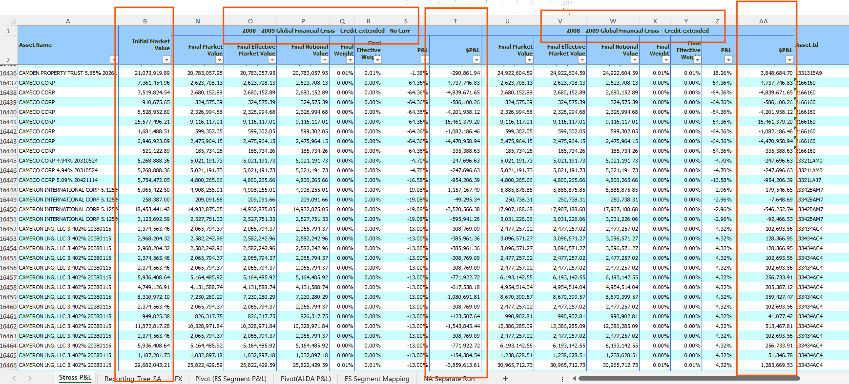
A. BarraOne Asset Impact – Sample Stress Test Report

Slide 7
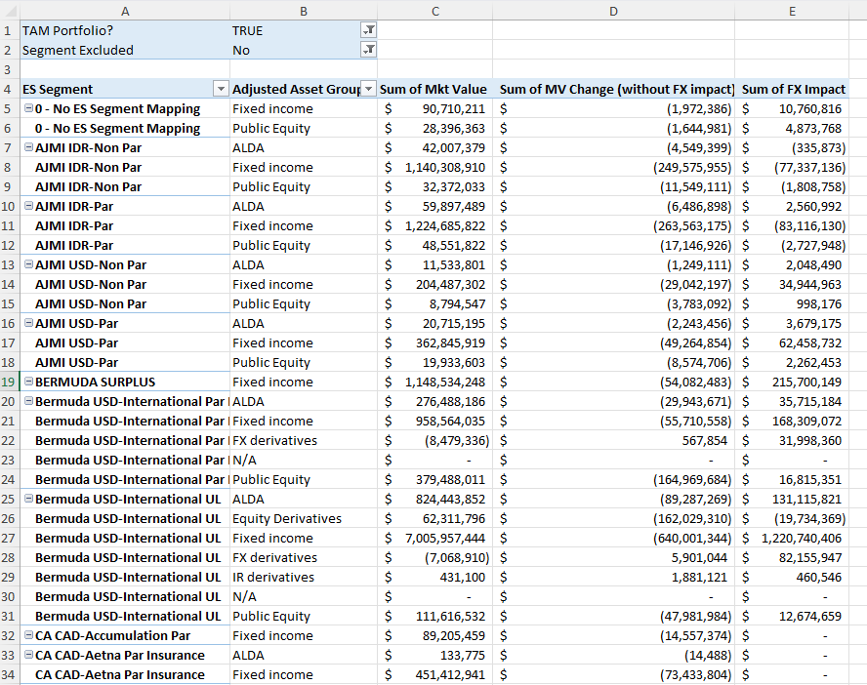
A. BarraOne Asset Impact – Sample Segment Impact

Slide 8
Stress Test Automation – B. Shock Conversion
ES Segment Mapping
ES Segment
Currency
…
Input (Source)
Join Key
Intermediate Data / Output
ES Segment Mapping
Interest Rate (IR) and FX Shocks
IR and FX Shocks
ES Segment
ES Sensitivity Type (RF, CS, SS) or FX
Shock Unit
Shock Size
B1SceShock-ES Mapping
B1 Shock Type
Currency
ES Sensitivity Type
Detailed ES Sensitivity Type
B. Shock factors for sensitivity blending
B1 Scenario Shock – ES Sensitivity Mapping
B. ES Blending Factors
ES Segment
Detailed ES Sensitivity Type + FX
Blending Factors
B1 Scenario Shocks
B1 Shock Type
Shock Unit
Shock Size
A
Stress Scenario IR and FX Shocks (B1)
Public Equity and ALDA Shocks
PE and ALDA Shocks
ES Segment
ES Sensitivity Type (PE or ALDA)
MV Change % without FX

Slide 9
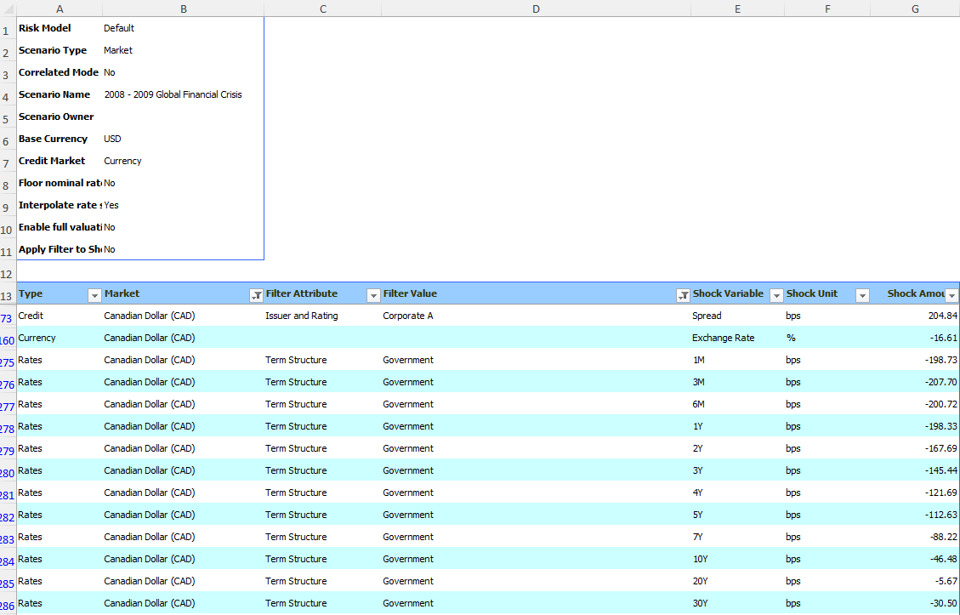
B. Shock Conversion – Sample BarraOne

Slide 10
B. Shock Conversion – ES Sensitivity Type and Sample Shocks
ES Sensitivity Type | Currency | Tenor | Shock Unit | Shock Size
RF | USD | 2y | bps | -150
RF | USD | 5y | bps | -120
RF | USD | 7y | bps | -90
RF | USD | 10y | bps | -50
RF | USD | 20y | bps | -40
RF | USD | 30y | bps | -50
CS | CAD |  | bps | 200
SS | CNY |  | bps | -20
PE |  |  | % | -16
ALDA |  |  | % | -5
FX (base currency = CAD) | USD |  | % | 15

Slide 11
B. Shock Conversion – ES Sensitivity Factor Conversion
ES Sensitivity Type | Tenor | Shock | Detailed ES Sensitivity Type | Converted Shock Factors
RF | 7y | -90bps | RF-50bps 7yr Only | 20%
RF | 7y | -90bps | RF+50bps 7yr Only | 0%
RF | 7y | -90bps | RF-100bps 7yr Only | 80%
RF | 7y | -90bps | RF+100bps 7yr Only | 0%
CS |  | 200bps | CS+50bps | 400%
CS |  | 200bps | CS-50bps | 0%
SS |  | -20bps | SS+20bps | 0%
SS |  | -20bps | SS-20bps | 100%
PE |  | -16% | PE-40% | 40%
PE |  | -16% | PE-10% | 0%
PE |  | -16% | PE+10% | 0%
ALDA |  | -5% | ALDA-10% | 50%
ALDA |  | -5% | ALDA+10% | 0%

Slide 12
Stress Test Automation – C. ES-based Liability/Net Impact
Quarterly Earning Sensitivity
ES Segment
Asset, Liability, Net
P&L, OCI, CSM
Detailed ES Sensitivity Type
Quarterly Earning Sensitivity
ES Segment
Asset, Liability, Net
P&L, OCI, CSM
Detailed ES Sensitivity Type (+ non-parallel RF sensitivity)
Quarterly ES Wave 1 & Wave 2 (ALM)
C. ES-Based Impact
ES Segment
Asset, Liability, Net
P&L, OCI, CSM
Asset Group (IR, PE, ALDA)
Blended Sensitivity (no FX)
Passthrough Ratio
PT Ratio Indicator
Quarterly Earning Sensitivity
Base Total Asset
Base Liability
B. ES Blending Factors
ES Segment
Detailed ES Sensitivity Type
Shock Factors
ES Segment Mapping
B. Shock factors for sensitivity blending
B
ES Segment Mapping
ES Segment
Category
ES Scaling Method
Currency
Tax Rate
Minority Interest
…
C. ES-based liability/net impact + FX Impact
B. ES Blending Factors
ES Segment
FX (Currency)
Shock Factors
C. ES-Based Impact
Base Currency (FX) Translation
Sensitivity FX
Input (Source)
Join Key
Intermediate Data / Output

Slide 13
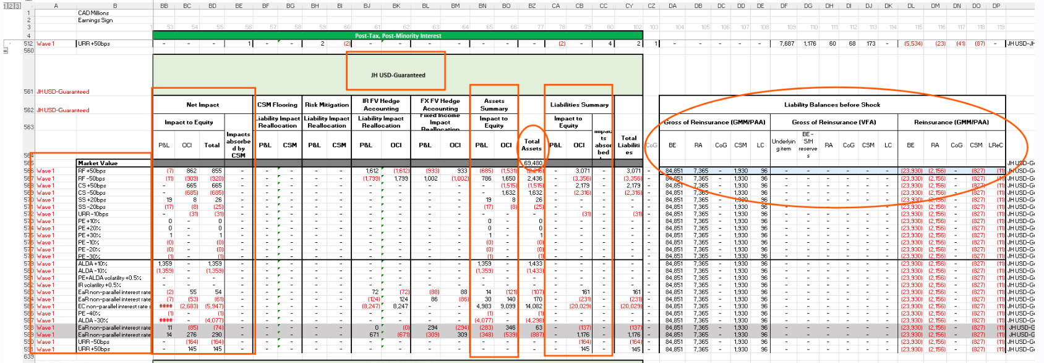
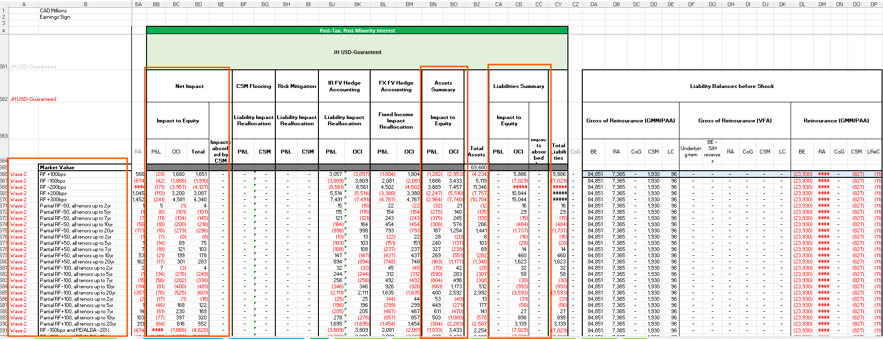
C. ES-based Liability/Net Impact – ES Sample

Slide 14
C. ES-based Liability/Net Impact – Detailed ES Sensitivity
Detailed ES Sensitivity Type | Wave 1, Wave 2 or Further Derived from Wave 1&2
RF-50bps 7yr Only | Derived (Wave 2): ‘Partial RF-50, all tenors up to 7yr’ – ‘Partial RF-50, all tenors up to 5yr’
RF+50bps 7yr Only | Derived (Wave 2): ‘Partial RF+50, all tenors up to 7yr’ – ‘Partial RF+50, all tenors up to 5yr’
RF-100bps 7yr Only | Derived (Wave 2): ‘Partial RF-100, all tenors up to 7yr’ – ‘Partial RF-100, all tenors up to 5yr’
RF+100bps 7yr Only | Derived (Wave 2): ‘Partial RF+100, all tenors up to 7yr’ – ‘Partial RF+100, all tenors up to 5yr’
RF 5y, 10y, 20y Only | Derived in the same way as ‘RF 7yr Only’
RF-50bps 2yr Only (similar for +50bps, -100bps, +100bps) | Wave 2: ‘Partial RF-50, all tenors up to 2yr’
RF-50bps 30yr Only (similar for +50bps, -100bps, +100bps) | Derived: ‘Partial RF-50’ (Wave 1) – ‘Partial RF-50, all tenors up to 20yr’ (Wave 2)
CS+50bps, CS-50bps | Wave 1
SS+20bps, SS-20bps | Wave 1
PE-40%, PE-10%, PE+10% | Wave 1
ALDA-10%, ALDA+10% | Wave 1
Milestone

Slide 15
Methodology Assumptions used for stress test using BarraOne and Liability overlay
Certain segments are excluded due to immaterial impacts.
Investment contracts are assumed to be fully passed through to the policyholders, no P&L nor balance sheet impacts.
Interest Rate
Guaranteed/Surplus/NPT segments: asset impacts are calculated using BarraOne while corresponding liability impacts are prorated based on earnings sensitivities.
Par Segments: P&L and OCI passthrough ratios are calculated based on segment-specific earnings sensitivities and applied to BarraOne asset impacts to derive net impacts.
Passthrough/VUL/Pension Segments: The net impacts are prorated based on earnings sensitivities using BarraOne shocks.
Assume hedge accounting is fully effective (no P&L impacts).
Public Equity
MV impact of direct equity (General Account) is calculated by BarraOne with a couple of exceptions: portfolio 2H7B and external COLI, where the MV change is estimated with equity and currency scenario shocks as those two portfolios are still not in the EDL.
MV impact of direct equity is assumed to be 100% to P&L, i.e., FVTPL. Liability impacts on P&L and CSM are prorated using ES.
Impacts of indirect exposure (Separate Account impact on OCI and CSM) is prorated using ES (i.e., for Pension, VUL, and VA).
MV change of PE derivative is assumed to be 100% offset by liability P&L.
Currency
Similar as for interest rate risk, assume hedge accounting is fully effective (no P&L impacts).

Slide 16
Appendix

Slide 17
Current BarraOne Stress Test Process (Excel-based)
Asset Impact without FX and FX Impact by ES Segment and Adjusted Asset Group
BS Impact Summary Template
Portfolio – ES Segment Mapping
BS Impact (excl. FX) Summary (Liability ES, non-Par)
ES Segment Mapping (Category, ES Scaling Method, Investment Contract)
Asset Impact with FX and without FX (B1);
GA Position (B1, Internal)
BarraOne Asset Impact Summary
ES-based IR, ALDA Liability/Net Balance-Sheet (BS, P&L/OCI/CSM) Impact;
Public Equity Asset/Liability/Net BS Impact by ES Segment
B1 ALDA Shock Factors by ES Segment
BS Impact (excl. FX) Summary (Liability ES, Par)
ES Segment Mapping (Category, ES Scaling Method, Currency, Tax, Minority Interest)
BS Impact (excl. FX) Summary (Net ES)
Net BS Impact by Asset Group (IR, Public Equity, ALDA, Currency(FX)) and ES Segment
Interest Rate(IR), ALDA Earning Sensitivity Summary
Passthrough Ratio and Indicators for Par Segment
FX BS Impact Summary (Liability ES, non-Par)
Quarterly Earning Sensitivity(ES) Wave 1;
Earning Sensitivity Wave 2 (ALM)
Public Equity(PE) Impact Summary
ES-based FX Liability/Net BS Impact (Base Currency Translation + IR, ALDA Sensitivity);
FX BS Impact (PE Base Currency Translation + PE Sensitivity)
FX BS Impact Summary (Liability ES, Par)
Earning (P&L) and BS Impact at company level by Asset Group
Stress Scenario IR and FX Shocks (B1)
B1 PE Shock Factors by ES Segment
FX BS Impact Summary (Net ES)
Input (Source)
Template
Intermediate Data / Output

Slide 18
BarraOne Stress Test Automation – Data Format
B1 Stress P&L
Initial Market Value
Asset ID
P&L without FX
P&L with FX
B1 Reporting Tree
Market Value (MV)
Asset ID
Level 2 (Segment)
Level 4 (Portfolio Code)
Primary Security Id
Adjusted Asset Group
A. B1 Asset Impact
ES Segment
Adjusted Asset Group
MV Change without FX
MV Change with FX
FX Impact
D/E. Net Impact Summary
ES Segment
Category
P&L, OCI, CSM
Asset Group
Net Impact
C. ES-Based Impact
ES Segment
Asset, Liability, Net
P&L, OCI, CSM
Asset Group (IR, PE, ALDA, FX)
Blended Sensitivity (no FX)
Base Currency (FX) Translation
Sensitivity FX
Passthrough Ratio
PT Ratio Indicator
Portfolio – ES Segment Mapping
Portfolio Code
ES Segment
PR and ALDA Shocks
ES Segment
PE or ALDA
MV Change % without FX
B. ES Blending Factors
ES Segment
Detailed ES Sensitivity Type + FX
Shock Factors
Net Impact (MFC)
P&L, OCI, CSM
Asset Group
Net Impact
B1SceShock-ES Mapping
B1 Shock Type
Currency
ES Sensitivity Type
Detailed ES Sensitivity Type
ES Segment Mapping
ES Segment
Category
ES Scaling Method
Currency
Tax Rate
Minority Interest
Investment Contract
Quarterly Sensitivity | Examples
ES Segment | JH USD Guaranteed
Asset, Liability, Net | Asset, Liability, Net
IFRS17 Component | P&L, CSM, OCI
ES Sensitivity Type | CS, RF, SS, PE, ALDA
Detailed ES Sensitivity Type | CS-50, RF+50, Partial RF-50-all tenors up to 10yr, PE-40%, ALDA-10%
Base Total Asset
Base Liability
B1 Scenario Shocks
B1 Shock Type
Shock Unit
Shock Size
Input | Intermediate Data | Final Output
Notes:
Partial RF-50, all tenors up to 10yr

Slide 19
Stress Test Automation – A. BarraOne Asset Impact
Input:
BarraOne provides security-level market value (MV) stress impacts (with FX shocks, without FX shocks)
GA Position/Holdings with TAM Segment, portfolio, security ids (B1 Manulife Reporting Tree, Internal)
Portfolio – ES Segment mapping (manual)
Output:
BarraOne asset impact (without FX) by ES Segment and Adjusted Asset Group
FX (asset) impact by ES Segment and Adjusted Asset Group
Current Process:
Pull security-level price change % from B1.
Calculate the position-level MV impact.
Aggregate MV impacts by ES segment.
Adjustments:
Replace MV impact of NDF-RA and flat-spread IRS with internal stress values (due to valuation gap).
Manually add impact for COLI and 2H7B (not yet in BarraOne).
Automation Note:
Once the gaps in step 5 are resolved, BarraOne’s portfolio-adjusted asset group stress test reports can be combined with 1c for the final output. Automation can be achieved without 1a/b, 3a/b, and 4a/b.
Current portfolio stress test reports cannot be used for asset allocation.

Slide 20
Stress Test Automation – B. Shock Conversion
Input:
BarraOne scenario shocks
BarraOne Asset impact (without FX) by ES Segment
Current Process and Output:
Get IR (RF, CS, SS) shocks and FX shocks from 1a.
Term structure shocks are needed for RF.
If shock unit is relative in % instead of absolute in bps, base risk factor numbers are needed to calculate the shocks in bps. E.g., CS shocks in a factor scenario.
Get Public Equity and ALDA shocks from 1b.
Convert shocks to factors for ES sensitivity blending
IR factors for RF+-50/100 partial, CS+-50, SS+-20 by currency
PE: -40%/+-10% and ALDA: +-10% by ES Segment
FX: Convert to CAD-based % shock
Automation Note:
Scenario shocks differ between BarraOne market scenarios (e.g., GFC) and factor scenarios (e.g., US Tariff). Different translators are required.
Create a mapping of ES Segment → Sensitivity → Shock factors to make downstream blending easier

Slide 21
Stress Test Automation – C. ES-based Liability/Net Impact
Input:
Quarterly consolidated sensitivities (Wave 1 & Wave 2).
ES Segment mapping (product category, ES scaling method, currency, tax, minority interest).
All shock factors
Current Process and Output:
Retrieve sensitivities by ES segment:
Asset, Liability, Net sensitivities for P&L, OCI, CSM.
CS+-50, SS+-20, PE-40%/+-10%, ALDA+-10% from Wave 1.
Derive partial RF+-50/100 from Wave 1 & Wave 2.
Calculate stress impact
Blend sensitivities with shock factors to get Liability and Net impact.
Sum RF, CS, SS impact for total IR impact.
FX translation impact
Use base total asset/liability from 1a.
Methodology depends on ES scaling method (1b).
Public equity impact based on initial holdings MV.
FX impact on sensitivities
Apply FX shock factors to sensitivities (2b).
Calculation IR and ALDA passthrough ratios and indicators using 2a and IR/ALDA shock factors.

Slide 22
Stress Test Automation – D. Net Impact Summary
Input:
BarraOne Asset impact (without FX) by ES Segment and Adjusted Asset Group
FX (asset) impact by ES Segment and Adjusted Asset Group
ES-based Liability and Net impact by ES Segment and Asset Group
Base currency translation impact and FX sensitivity impact.
IR and ALDA passthrough ratios and indicators.
ES Segment mapping (product category, ES scaling method, investment contact indicators)
Current Process and Output:
Calculate Net Impact (excl. FX) by ES Segment:
“Net Scaling”: use ES-based net impact (1c).
“Liability Scaling (non-Par)”: use BarraOne asset impact (1a) + ES-based liability impact (1c).
“Liability Scaling (Par)” 1a + 1c + passthrough ratio (1e).
Calculate Net FX impact by ES Segment:
“Net Scaling”: use ES-based FX impact (1d).
“Liability Scaling (non-Par)”: use BarraOne FX (asset) impact (1b) + ES-based FX (liability) impact (1d).
“Liability Scaling (Par)” 1b + 1d + passthrough ratio (1e).
Special rule: For investment contracts, remove all asset and FX impacts except public equity.
E. Aggregate:
Combine impacts by ES Segment and Asset Group (Interest Rate, Public Equity, ALDA, FX)
Roll up to total company level.
Notes:
Combine impacts by ES Segment and Asset Group (Interest Rate, Public Equity, ALDA, FX) Roll up to total company level

Slide 23
BarraOne Stress Test Automation
Automation Split | Notes, Challenges
A. BarraOne Asset Impact | Portfolio-ES Segment Mapping – Map portfolios to ES segment for grouping. Use Customized BarraOne Reports for automation – Stress test reports with portfolio and adjusted asset group as cuatomized groups Resolve Valuation Gaps – Fix gaps in B1 for NDF-RA and flat-spread IRS to avoid position level adjustments. Inbound Report Handling – Automation should handle two-level customized reports. (Current portfolio stress test reports cannot be used for asset allocation.)
B. Shock Conversion | Convert BarraOne scenario shocks to required IR (RF, CS, SS) and FX shock factors. Build separate translators for market vs factor scenarios. Convert PE and ALDA returns from A to required shock factors. Convert shocks to factors for sensitivity blending: ES Segment → Detailed ES Sensitivity Type → Shock → Shock Factors (for downstream blending).
C. ES-based Liability/Net Impact | ES Segment mapping with details: category, scaling method, currency, investment contract indicator, etc. Use Wave 1 & Wave 2 sensitivities for RF. (Confirm if Wave 1 and Wave 2 sensitivities are available in EDL.) Get base asset and liability values for currency translation. Derive Passthrough ratios and indicators.
D. Net Impact Summary, E. Aggregation | Calculate net impact by ES segment using: Net Scaling , Liability Scaling and passthrough ratios for Par segments, Liability Scaling for other segments. For investment contracts, include only Public Equity (exclude other asset/FX impacts). Aggregate by asset group (FI, PE, ALDA, FX) into IFRS 17 components (P&L, OCI, CSM)

